Slide 1


Presentation title slide
Identifying and Categorizing Offensive Language in Social Media
THE WEKA MINERS
Notes:
Hi Everyone,
This is a presentation on Identifying and Categorizing Offensive Language in Social Media

Slide 2
Text hierarchy and formatting information slide
Outline
Business Understanding
Data Understanding
Data Preparation
Modeling
Evaluation
Tools used
Notes:
The outline for this presentation follows the CRISP-Data Mining Framework without the Deployment Stage and the Tools used during the mining process

Slide 3
Text hierarchy and formatting information slide
Business Understanding
Business Objective
Identify offensive language from tweets, determine whether they are targeted, and identify whether they are targeted at an individual, a group of people or a category other than an individual or group.
Data Mining Objective
Prepare given training dataset of annotated tweets for modeling, train a number of models on prepared training data, evaluate models on given test data, and analyze and compare the results for three tasks; offensive language identification, automatic categorization of offense types; and offense target identification.
Success Criteria
The accuracy and simplicity of the trained models evaluated on the test data.
Notes:
Social Media platforms, like Twitter, are large avenues for human interaction and are therefore also large avenues for the expression of sentiments; some of which can be offensive.
For our business objective, we aim to achieve three things; 1st , to identify offensive language from tweets, next, to determine whether these offensive tweets are targeted or untargeted, and finally, if targeted, identify whether they are targeted at an individual, a group or an other category.
Our data mining objective declares how we achieve this:
1st, we prepare given training and test datasets of annotated tweets for modeling and evaluation
2nd, we train a number of models on training data and evaluate on test data
3rd, we analyze and compare the results
We carry out this process on the 3 tasks specified in our business objective.
Our criteria for success is the accuracy and simplicity of the developed models

Slide 4
Text hierarchy and formatting information slide
Data Understanding
Data collection: The data used for training the models and testing them were obtained from Minerva (The University of Leeds VLE) in various file formats (mainly .tsv and .csv files with UTF-8 encoding)
Data description: The table below describes a high level profile summary of the collected data.
File name | File size | No. of records | No. of attributes
olid-training-v1.0.tsv | 1929 KB | 13240 | 5
testset-levela.tsv | 132 KB | 860 | 2
testset-levelb.tsv | 35 KB | 240 | 2
testset-levelc.tsv | 33 KB | 213 | 2
labels-levela.csv | 10 KB | 860 | 2
labels-levelb.csv | 3 KB | 240 | 2
labels-levelc.csv | 3 KB | 213 | 2
Notes:
The data used for training and testing the models were obtained from The University of Leeds VLE mainly as tab separated and comma separated values.
The table displayed shows a short profile of the given data; the file types, no. of records and no. of attributes). The given datasets were all UTF-8 encoded.

Slide 5
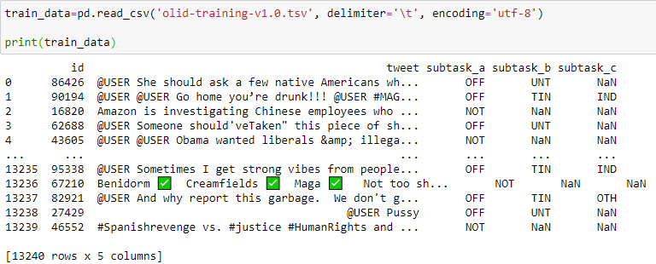
Full sized image slide
Data Description and Exploration:
The pandas code above displays a sample of the data contained in the training set (olid-training-v1.0.tsv) as shown in the output
Notes:
Exploring a sample of the data shows that it is quite noisy and will therefore need to undergo some data preparation to make it suitable for modeling and evaluation.

Slide 6
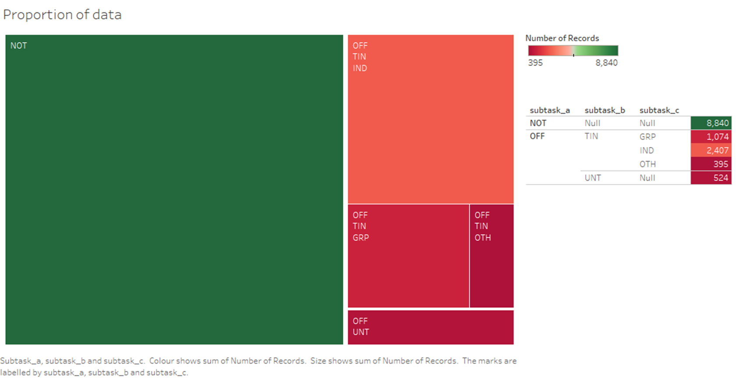
Full sized image slide
Data Description and Exploration:
Proportion of the various classes of tweets for each subtask in the training set (olid-training-v1.0.tsv) visualized with Tableau
Notes:
Further exploration of the given training data using Tableau results in the displayed visual which shows the proportion of the different classes of tweets for each of the three tasks. Looking at the proportion of non-offensive tweets present in the training data, an educated guess can be made that our trained models might be better suited to identify non-offensive tweets than offensive ones.

Slide 7
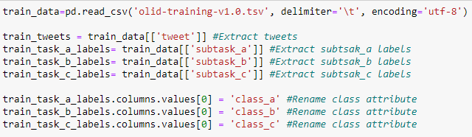
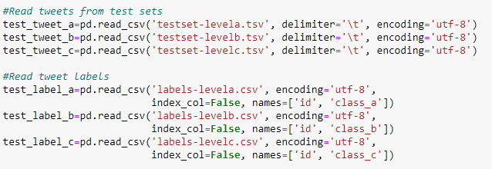
Text hierarchy and formatting with two images slide
Data Preparation
A number of consolidation and cleaning process outlined below were applied to make the data suitable for modeling and evaluation
Convert .tsv files to .csv
Extract tweets into data frame to process separately
Extract subtasks (a, b & c) columns into separate data frames
Remove specially coded strings (&lt(<), &gt(>)) from tweets
Replace ‘&amp’ with ‘and’
Remove emojis from tweets
Notes:
The Data Preparation phase was carried out by a number of extraction, cleaning and consolidation processes to make the data suitable for modeling and evaluation.
These included removing emojis, mentions (denoted with @USER), urls (denoted with URL) and punctuations from the tweets.

Slide 8
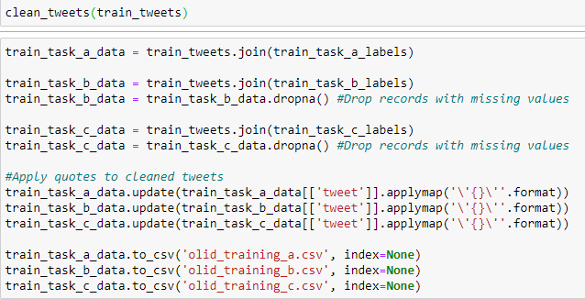
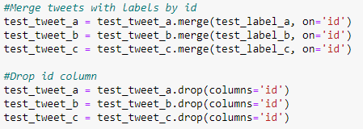
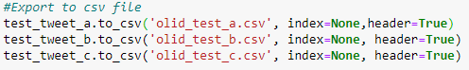
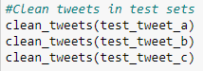
Text hierarchy and formatting with two images slide
Data Preparation (con’td)
Remove mentions (@USER) and urls (URL) from tweets
Remove punctuations from tweets
Merge cleaned tweets with extracted subtask classes into three separate datasets for each subtask
Export prepared training data to .csv files
Clean tweets in test set with cleaning processes specified above
Merge test set tweets with respective labels
Export cleaned and merged test data to .csv

Slide 9
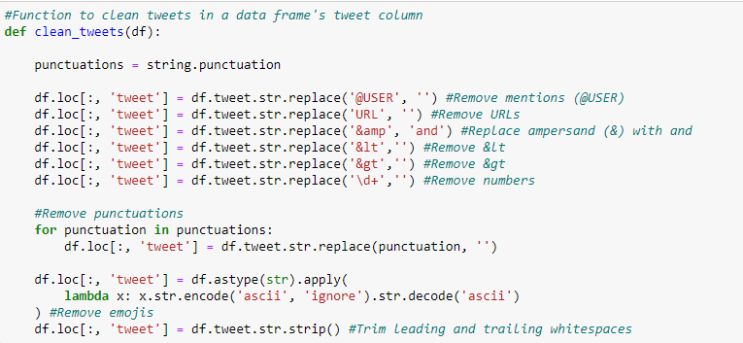
Full sized image slide
Data Preparation
Python function for cleaning tweets from a data frame containing a tweet column using pandas
Notes:
The code sample shows a python function that was written to clean the tweets in the datasets with the help of the python string library and pandas library.

Slide 10
Full sized image slide
Data Preparation: Profile of training and test set after data preparation
File name | File size | No. of records | No. of attributes
Training sets
olid_training_a.csv | 1466 KB | 13240 | 2
olid_training_b.csv | 529 KB | 4400 | 2
olid_training_c.csv | 479 KB | 3876 | 2
Test sets
olid_test_a.csv | 10 KB | 860 | 2
olid_test_b.csv | 3 KB | 240 | 2
olid_test_c.csv | 3 KB | 213 | 2
Notes:
This table shows a profile of the generated training and test datasets after the data preparation phase.

Slide 11
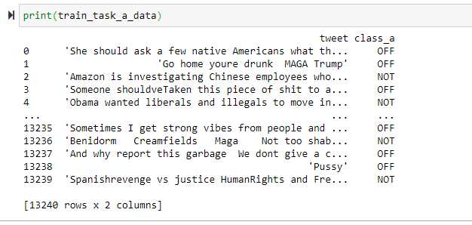
Full sized image slide
Data Preparation: Sample of training data after data preparation
A sample of the data contained in one of the three prepared training sets (olid_training_a.csv) as shown in the output
Notes:
A sample of the training data after preparation reveals that it is now clean and suitable for modeling.

Slide 12
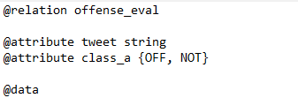
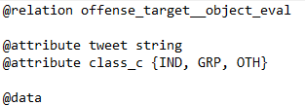
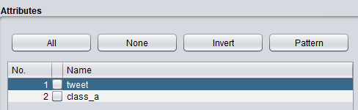
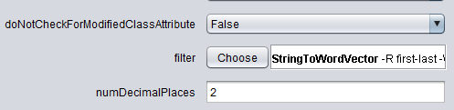
Text hierarchy and formatting with an image slide
Data Preparation (con’td)
The .csv files were converted to .arff files by preprending the header text of .arff files which specify the relation along with the attributes and their data types making them suitable for modeling in Weka.
The final data preparation task carried out was to convert the tweets in both the training and test set which are strings to word vectors by applying the StringToWordVector filter in Weka. This was done alongside modeling using the FilteredClassifier.

Slide 13
Text hierarchy and formatting with two images slide
Modeling
Based on the data mining objective, tweet analysis, these classifiers were used to build the models:-
Sequential Minimum Optimization
J48
Random Forrest
Naïve Bayes
Naïve Bayes Multinomial
Simple Logistics
Features:
Tokenizers
Confidence Factor
Notes:
to analyse the tweets, we built our models using these classifiers which have a good reputation for text analysis in weka. We then used the features to optimize the best model for each subtask.

Slide 14
Text hierarchy and formatting with two images slide
Modeling Subtask A
Models based on different classifiers were built using the supplied training set and test set.
The best performing model based on accuracy was then singled out and optimized further, investigating different parameters like tokenizers, Confidence factor.
Training data was uploaded in Weka. meta.FliteredClassifier was selected so that classification and filters were done at the same time. The filter used was string to word vector and the 6 different classifiers in the previous slides were used. See Comparative analysis in the evaluation

Slide 15
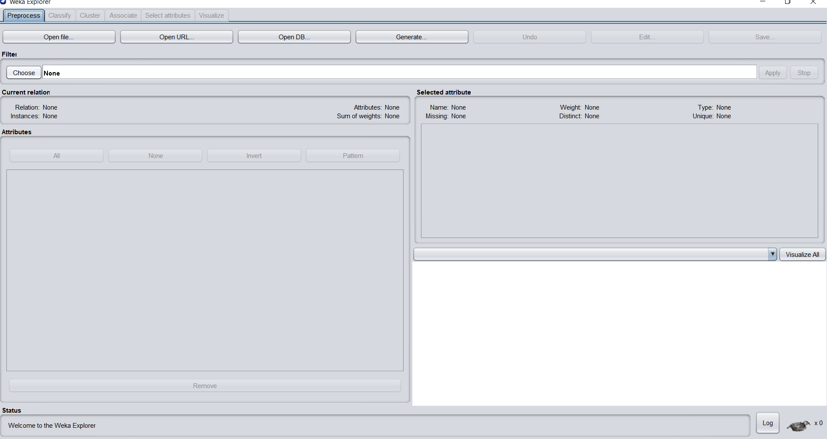
Text hierarchy and formatting with two images slide
Modeling Subtask A
Preprocess

Slide 16
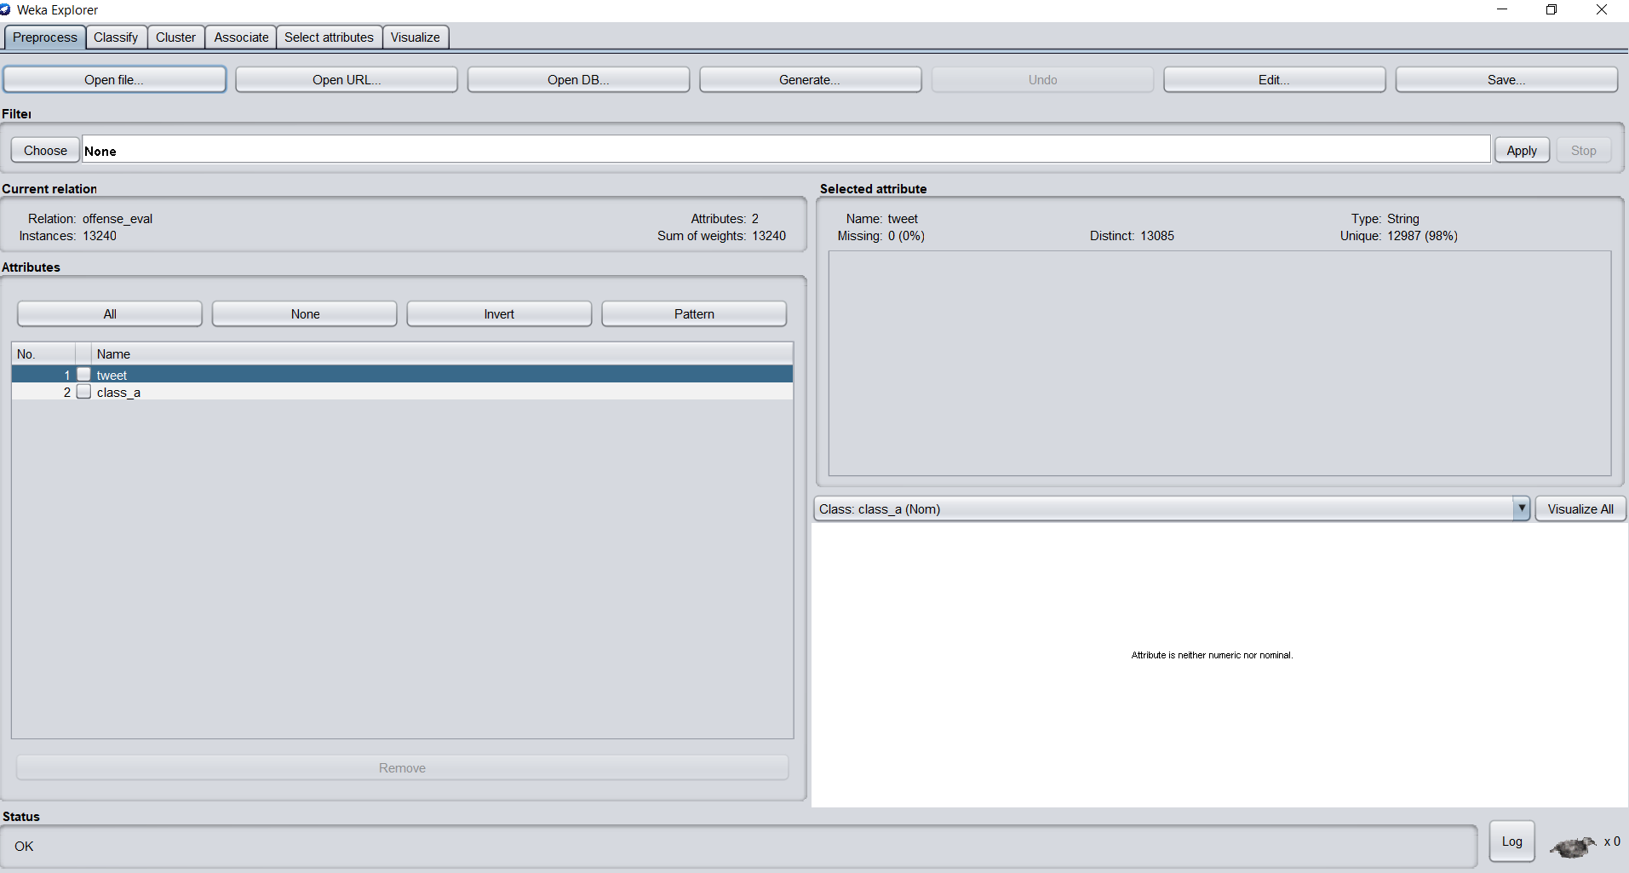
Text hierarchy and formatting with two images slide
Modeling Subtask A
Preprocess

Slide 17
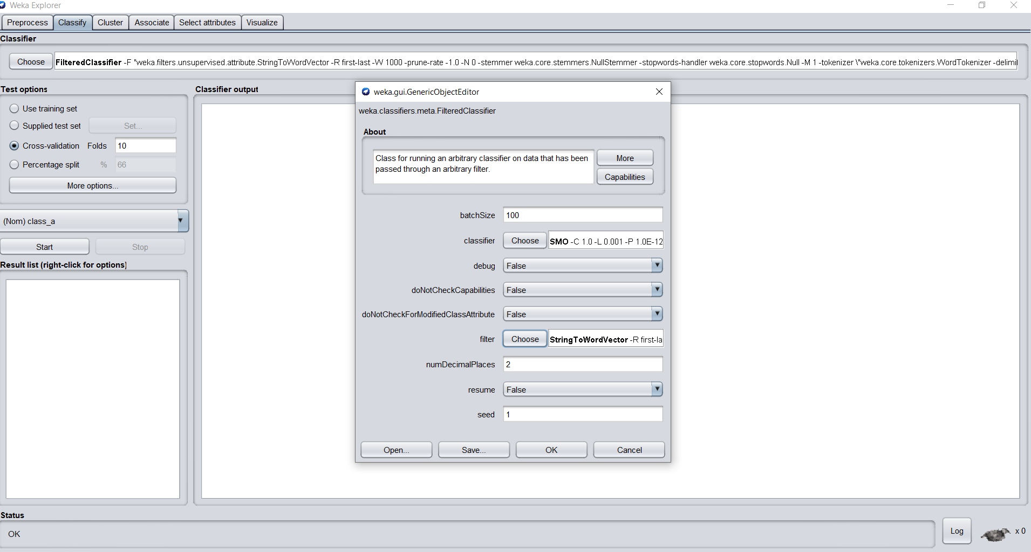
Text hierarchy and formatting with two images slide
Modeling Subtask A
Classify

Slide 18
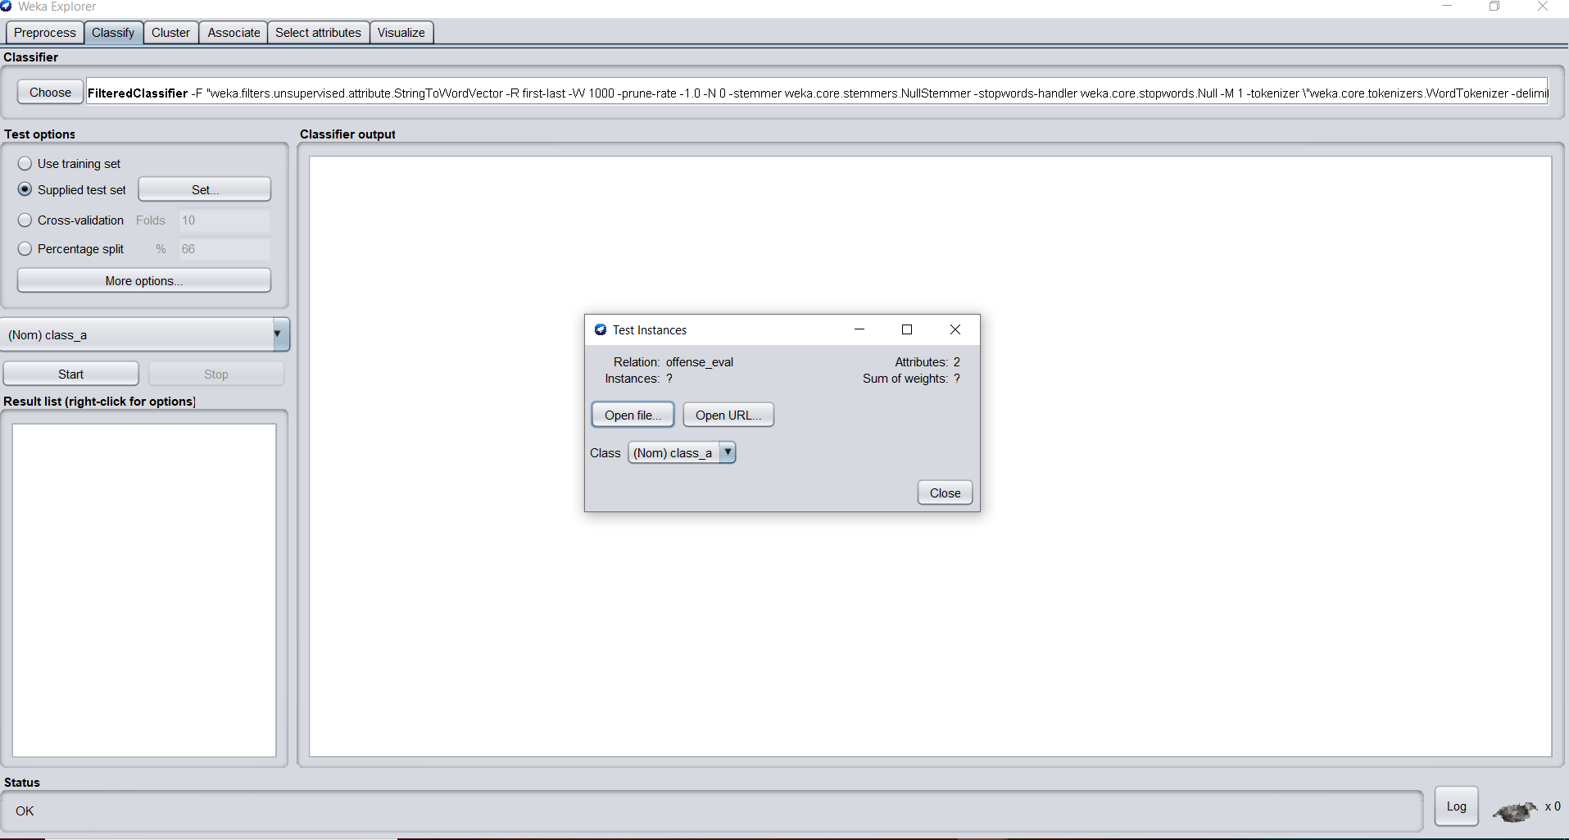
Text hierarchy and formatting with two images slide
Modeling Subtask A
Classify

Slide 19
Text hierarchy and formatting with two images slide
Modeling Subtask B and C
Same methodology was used in preprocessing and classification for subtask B and C as it was used for subtask A,

Slide 20
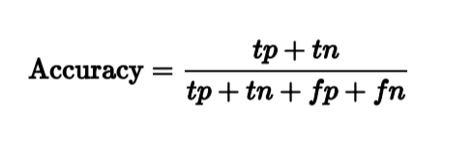
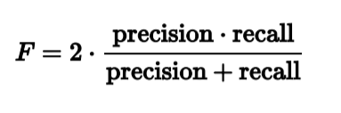
Text hierarchy and formatting with two images slide
Evaluation
The key metrics used to evaluate the performance of the models were:-
Accuracy which is the measure of correctly classified tweets
F1 score which is the measure that combines precision and recall. It is the harmonic mean of precision and recall.

Slide 21
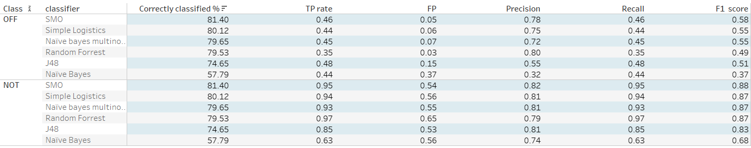
Text hierarchy and formatting with two images slide
Evaluation
Subtask A
Comparative Analysis of all the classifiers

Slide 22
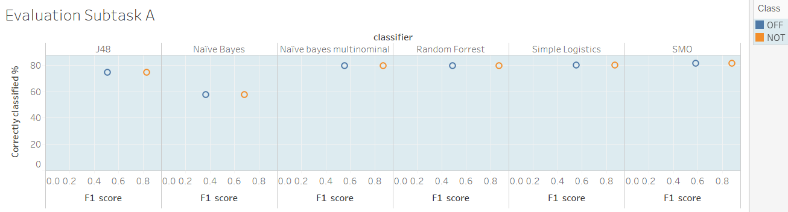
Text hierarchy and formatting with two images slide
Evalutation Subtask A
Optimizing best performing classifier
The best performing model was the one built using the SMO classifier.

Slide 23
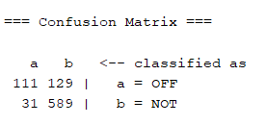
Text hierarchy and formatting with two images slide
Evaluation Subtask A
Optimizing best performing classifier
The best performing model was the one built using the SMO classifier.

Slide 24
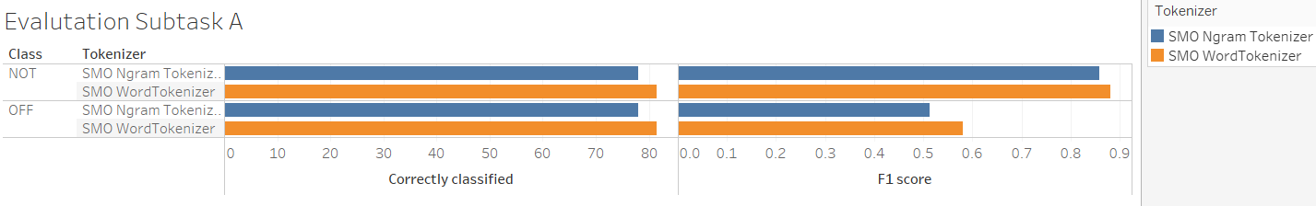
Text hierarchy and formatting with two images slide
Evaluation Subtask A
Comparative analysis of tokenizers
Notes:
Since smo classifier gave the best results, it was optimized using different tokenizer, Tokenization is the process by which big quantity of text is divided into smaller parts called tokens. N-grams are like a sliding window that moves across the word - a continuous sequence of characters of the specified length.

Slide 25
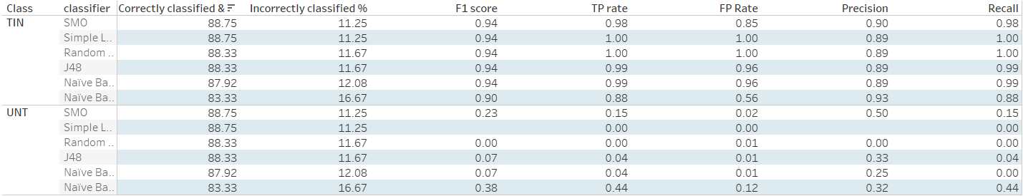
Text hierarchy and formatting with two images slide
Evaluation
Subtask B
Comparative Analysis of all the classifiers
Notes:
For task B, classifying tweets into targeted or untargeted classes, the smo classifier had the best performance

Slide 26
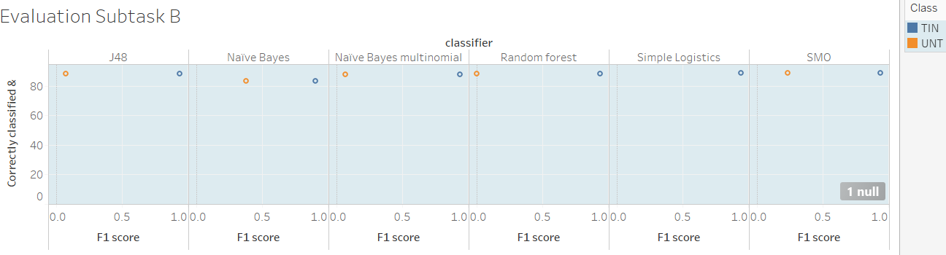
Text hierarchy and formatting with two images slide
Evalutation Subtask B
Optimizing best performing classifier
The best performing model was the one built using the SMO classifier.

Slide 27
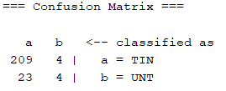
Text hierarchy and formatting with two images slide
Evaluation Subtask B
Optimizing best performing classifier
The best performing model was the one built using the SMO classifier.

Slide 28
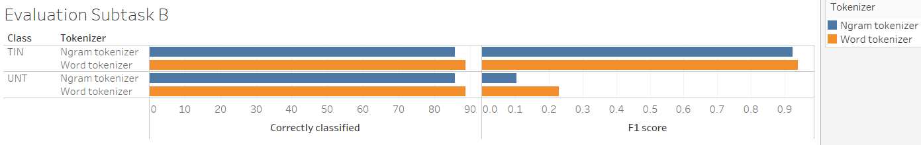
Text hierarchy and formatting with two images slide
Evaluation Subtask B
Comparative analysis of tokenizers
Notes:
Once again the word tokenizer outperforms the ngram tokenizer

Slide 29
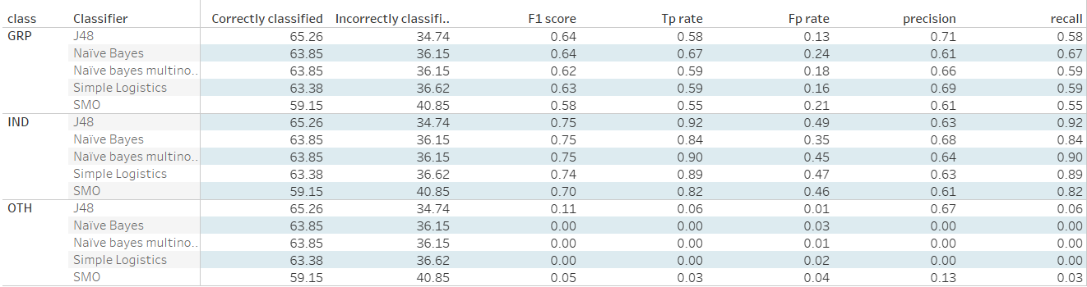
Text hierarchy and formatting with two images slide
Evaluation
Subtask C
Comparative Analysis of all the classifiers
Notes:
For task c, we classified tweets that were targeted into group, individuals and other.. The j48 tree classifier had the best performance

Slide 30
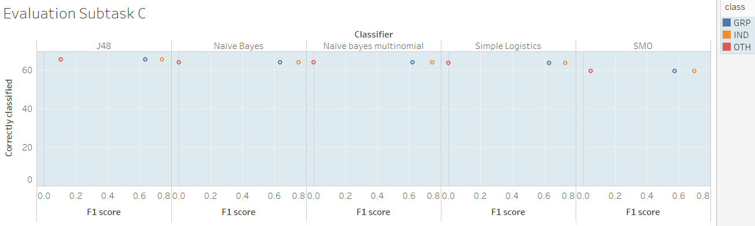
Text hierarchy and formatting with two images slide
Evalutation Subtask C
Optimizing best performing classifier
The best performing model was the one built using the J48 classifier.

Slide 31
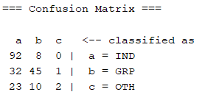
Text hierarchy and formatting with two images slide
Evaluation Subtask C
Optimizing best performing classifier
The best performing model was the one built using the J48 classifier.

Slide 32
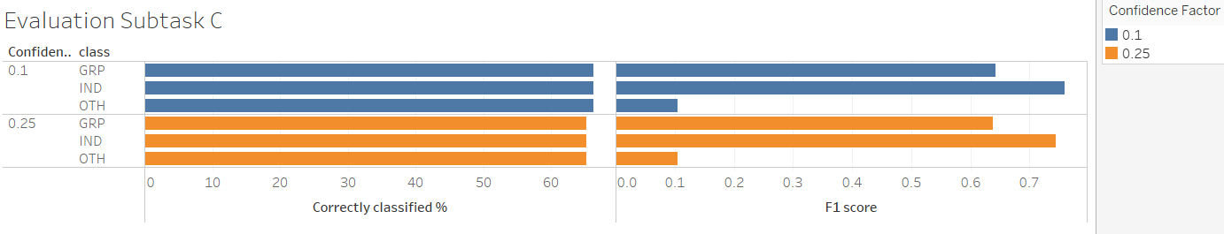
Text hierarchy and formatting with two images slide
Evaluation Subtask C
Comparative analysis of Confidence Factor

Slide 33






UK maps
Tools used

